Slide 1
Introducing evidence

Slide 2
Foundation basics for exhibits
Mark
Show
Approach
(in person)
Give

Slide 3
mark
Use pre-marked numbers when available
Tell judge if you are marking an unmarked document as an exhibit.
Say it all out loud – properly refer to exhibit at “Exhibit 6 for identification” until it is admitted into evidence.

Slide 4
Show/refer
Show (refer) marked exhibit to opposing counsel
Refer to it as “Exhibit 6 for identification”
Say it all out loud - make a record

Slide 5
Approach/ refer
Ask the judge for permission to approach the witness (in person)
Online: “Ms. Peyton please turn to Exhibit 6 in the exhibit binder before you.”

Slide 6
give
Give
Give (in person) or refer (online) witness to the marked exhibit
Refer
Refer to it as “Exhibit 6 for identification”
Do not publish
Do not publish to the jury until it has been admitted

Slide 7
Foundations
Ask the witness the necessary foundational questions
01
Request that the exhibit be admitted into evidence
02
Request to publish to the jury
03

Slide 8
Lay the foundation for admission
Different foundations for different types of evidence

Slide 9
photographs
“Do you recognize what has been marked as Government’s Exhibit 15 for identification?”
“What is it?”
If witness took the photograph
“Who took it?”
“When was it taken?”
“Is it a fair and accurate representation of ________ as it appeared [on the relevant day]?”

Slide 10
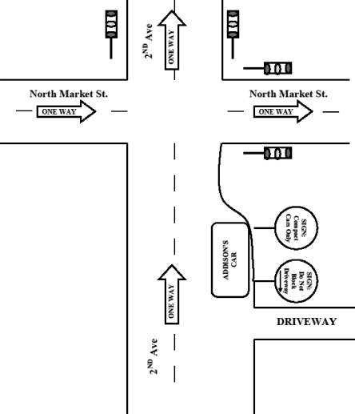
Diagrams
“Do you recognize what has been marked as Government’s Exhibit 16 for identification?”
“What is it?” “Did you create it?”
“Is it to scale?”
“Is it a fair and accurate representation of ________ as it appeared [on the relevant day]?”
“Will referring to this diagram assist your testimony today?”

Slide 11
Documents or other physical evidence
“Do you recognize what has been marked as Government’s Exhibit 17 for identification?”
“How do you recognize it?”
“What is it?”
→ Ask any additional and necessary foundation questions here…
…For example: questions related to how chain of custody was maintained for physical evidence, or that a document was made, kept, and created in the ordinary course of business of a particular company.
“Is it in the same or substantially the same condition as when you last saw it?”

Slide 12
After lay foundation – move to admit Exhibit
“Your Honor, we move to admit Exhibit 6 into evidence.”

Slide 13
After admitted ask the judge to publish to the jury
“Your Honor, may I publish Exhibit 6 to the jury?”
And then ask questions to elicit information you want the jury to know about the exhibit.

Slide 14
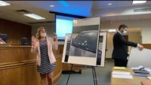
example Introducing photographs

